Slide 1
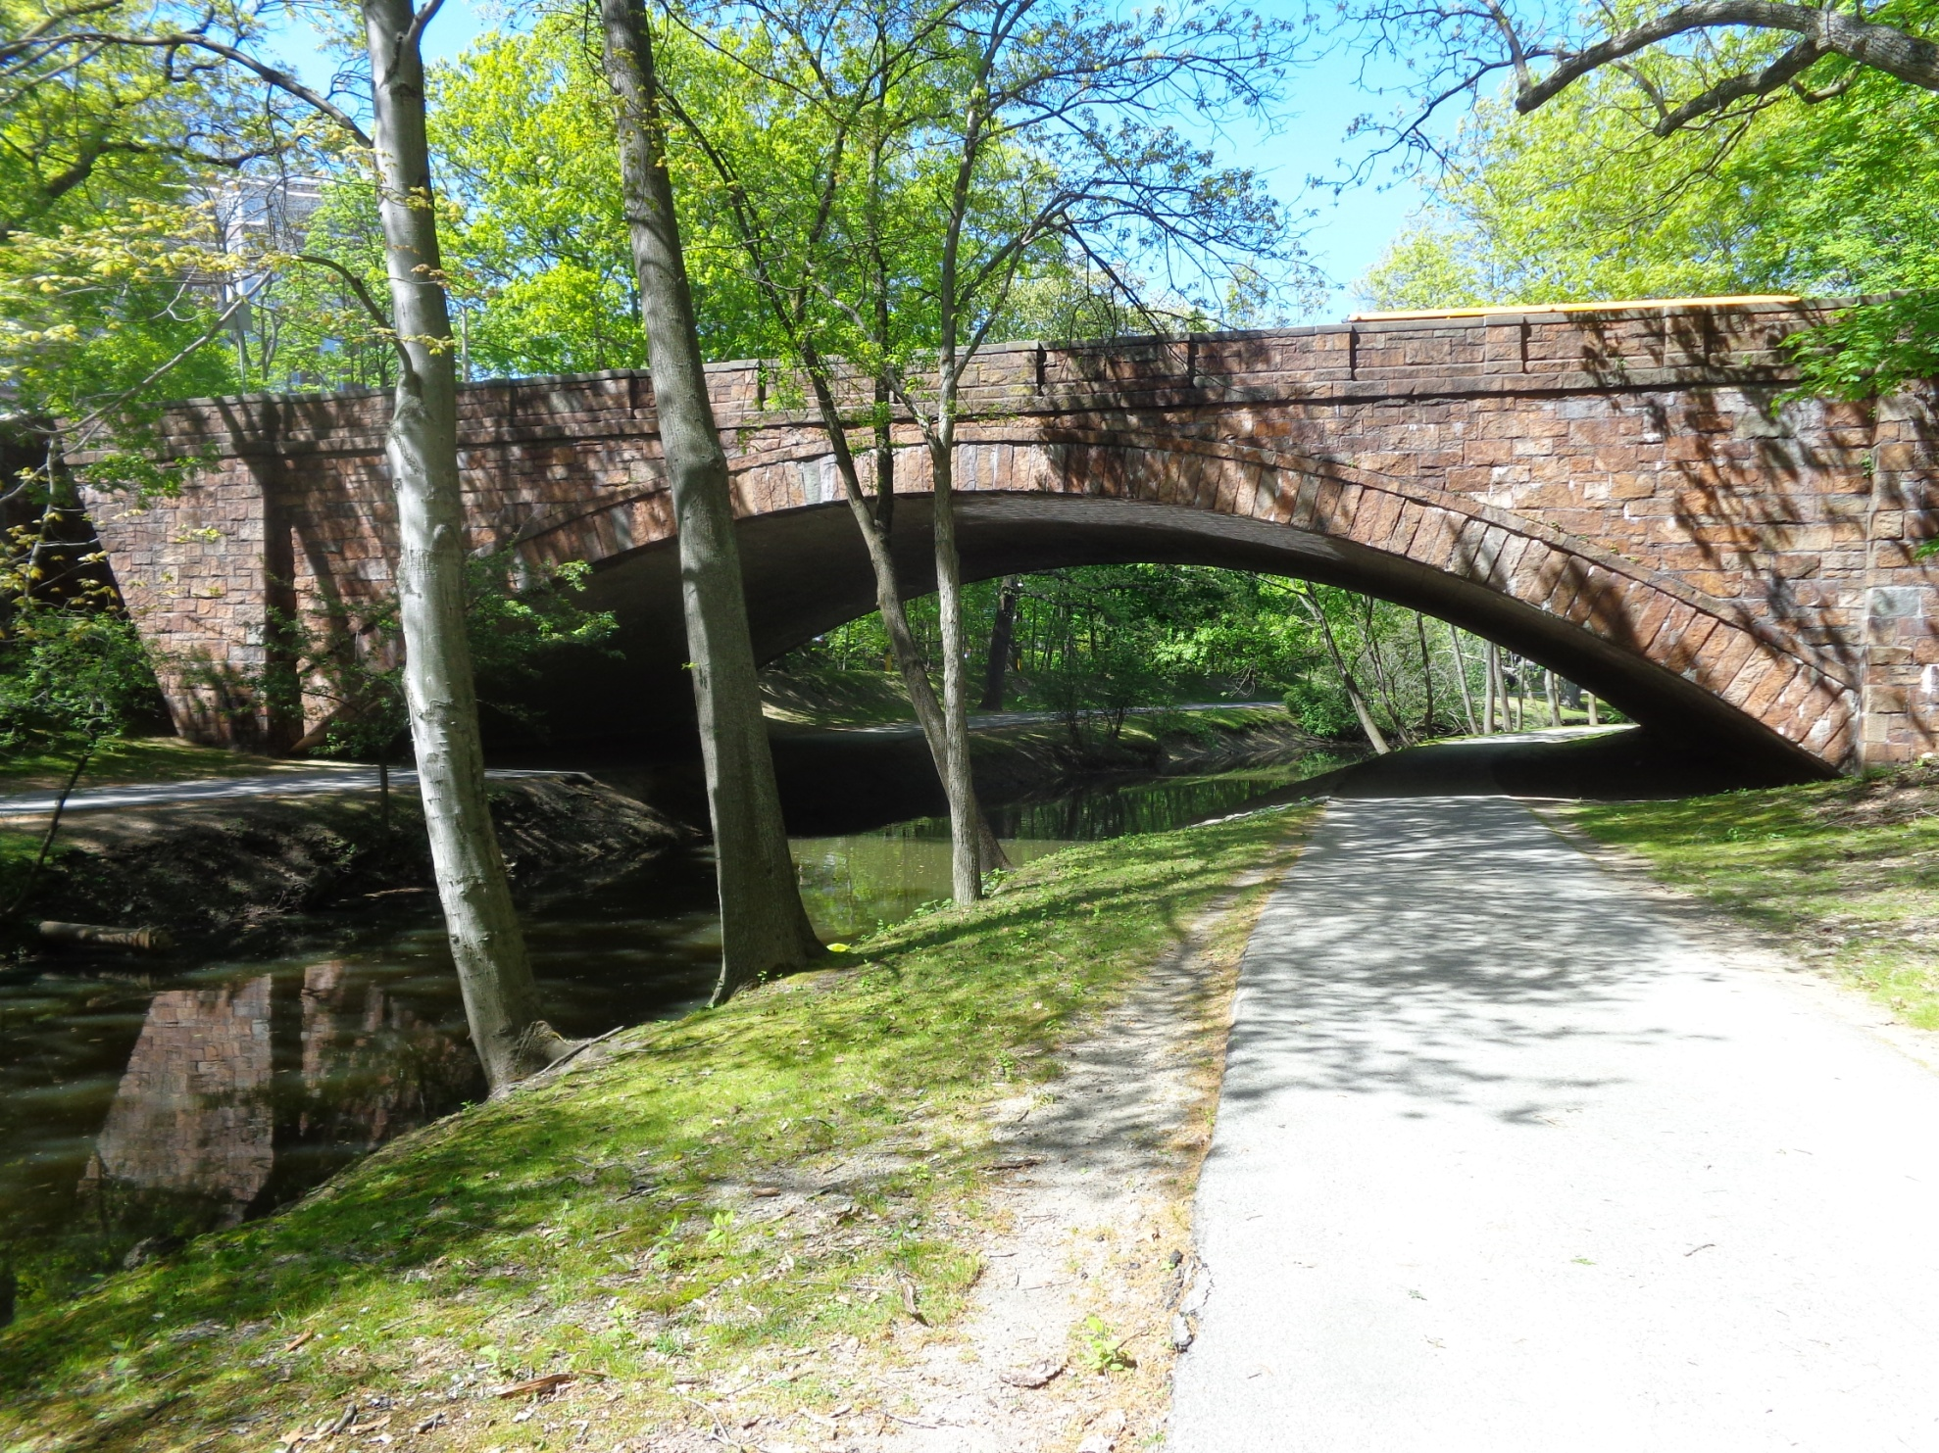

Looking back and looking forward.
Conclusion of DAY 1
Greg Moore
TREENET SYMPOSIUM
2024
Notes:
1

Slide 2
School of Ecosystem and Forest Sciences - Burnley
25 years of TREENET (Tree and Roadway Experimental and Educational NETwork)
TREENET pursues dual themes of Research & Education.
The dominant theme of the past was water and WSUD
Climate change emerged in more recent years
TREENET has been both follower and leader in providing a forum for the discussion of relevant concerns in urban forestry.
TREENET is effective in picking up trends and providing data-rich information to urban tree managers
Notes:
2

Slide 3
School of Ecosystem and Forest Sciences - Burnley
Looking to the Future – TREENET and the Urban Forest
Climate change and its consequences will be the greatest challenge to the urban forest and those managing it in the coming fifty years. There will be several aspects:
Temperature
Rainfall/Effective precipitation
Pests and diseases
Heat waves and related illnesses and deaths
Urban and peri-urban fires and fire management
Accessing and using data that informs climate change decisions
Notes:
3

Slide 4
School of Ecosystem and Forest Sciences - Burnley
Looking to the Future – TREENET and the Urban Forest
Where climate change hits hard the urban forest will be vital to the resilience and sustainability of urban ecosystems and their communities.
We should be planning and paying for changes in canopy cover now rather than retro-fitting an urban forest at a time of crisis.
Notes:
4

Slide 5
School of Agriculture, Food and Ecosystem Sciences - Burnley
Looking to the Future – TREENET and the Urban Forest
There will be other challenges and battles
The urban forest will be competing for space:
There will be fierce competition and battles for both Above and Below ground space
Against desperate and greedy Development policies/practices
Against roads, carparks and general infrastructure
We are currently losing these battles in most States and in some cases the battle for space has not even commenced.
Notes:
5

Slide 6
School of Agriculture, Food and Ecosystem Sciences - Burnley
Looking to the Future – TREENET and the Urban Forest
There will be other challenges and battles
Urban soils are rarely mentioned when it comes to the future management of urban forests:
Effects of Climate change Soil micro-fauna/flora
Soil moisture Competing for Space
Sustainability
If we don’t protect our soils, there is a real danger that we will lose them, they will degrade or we will lose control of them.
Notes:
6

Slide 7
School of Agriculture, Food and Ecosystem Sciences - Burnley
Looking to the Future – TREENET and the Urban Forest
There will be other challenges and battles
It is hard to believe that water will not be a more pressing matter as climate changes:
Cost
Type of water – potable, stormwater, grey water, mined, recycled....
Competing for water
Harvesting – how, where, why
Pavement types and purposes
Too much water and flooding
Notes:
7

Slide 8
School of Agriculture, Food and Ecosystem Sciences - Burnley
Looking to the Future – TREENET and the Urban Forest
There will be other challenges and battles
Economy/funding
Who will fund the urban forest
Federal , State, Local Government, private sector, combination ???
How will funds be made available – grants, subsidies, tax breaks???
The tension between trees and public benefit but owner cost
Cost/benefit analyses of the urban forest
The cost of closer scrutiny by government/community
Notes:
8

Slide 9
School of Agriculture, Food and Ecosystem Sciences - Burnley
Looking to the Future – TREENET and the Urban Forest
There will be other challenges and battles
TIME FRAMES
There are also matters dealing with time frames in relation to the urban forest
Human lifespans and time
Political/Planning cycles
Tree lifespans and time
Dealing with short term visions and long term treescapes
Notes:
9

Slide 10
School of Agriculture, Food and Ecosystem Sciences - Burnley
Looking to the Future – TREENET and the Urban Forest
There will be other challenges and battles
Community
Engaging with urban communities
Engaging with the rural/regional communities
Address the paradox that those who need and most benefit from treed greenspace (lower SES and disadvantaged groups) have the least access to it
Engaging with levels of Government LGA/State/Federal
Notes:
10

Slide 11
School of Agriculture, Food and Ecosystem Sciences - Burnley
Looking to the Future – TREENET and the Urban Forest
There will be other challenges and battles
TREENET will commit to Advocacy:
Targets of advocacy
Its Purpose will be measurably clear
Mechanisms of advocacy – many varied and changing (AI)
Risks of advocacy to reputation, impartiality, bias
Conclusion
Looking to the future is fraught but can ground and organisation and help plan strategy. TREENET is resilient, relevant and capable. There will be other challenges and battles.
Notes:
11

Slide 12
School of Ecosystem and Forest Sciences - Burnley
Notes:
12

Slide 13
Notes:
13

